Slide 1
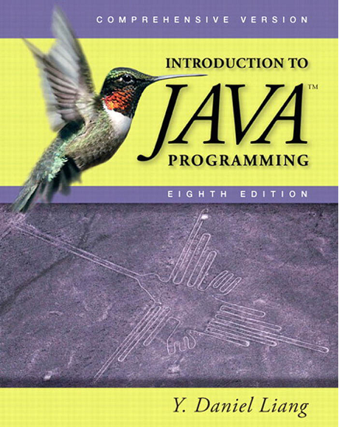

Slide 2
Chapter21 Generics
Chapter22 Java Collection Framework
Chapter29 Multithreading

Slide 3
Chapter 21 Java Generics

Slide 4
Introduction
Generic Class
Generic Methods
Wildcard Generic Type
Type inference
Erasure Restriction

Slide 5
Introduction
Generics is the capability to parameterize types.
You can define a class or a method with generic types that the compiler can replace with concrete types
The key benefit of generics is to enable errors to be detected at compile time rather than at runtime

Slide 6
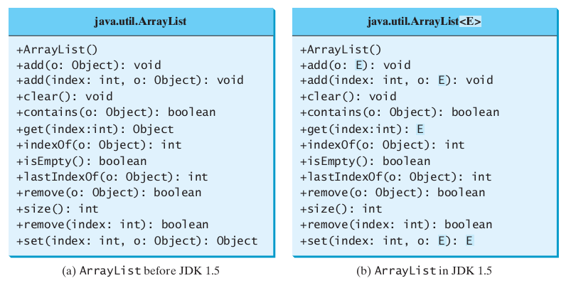
Introduction
Compare
Notes:
Class Person as demo
public class Person {
private String name;
private Integer age;
public Person(String name, Integer age) {
this.name = name;
this.age = age;
}
public String getName() {
return name;
}
public Integer getAge() {
return age;
}
public String toString() {
return name;
}
public static void main(String[] args) {
ArrayList<Person> persons = new ArrayList<Person>();
persons.add(new Person("a",20));
persons.add(new Person("b",19));
for(Person person : persons){
System.out.println(person.getAge());
}
}
}

Slide 7
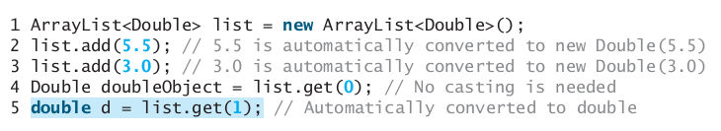
Introduction

Slide 8
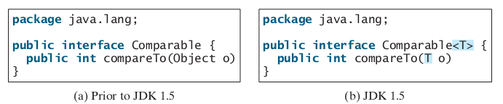

Introduction
Compare

Slide 9
Defining Generic Classes and Interfaces
Generic Class demo:
Stack demo
Generic Method demo
GenericMethodDemo

Slide 10
Bounded generic type
A generic type can be specified as a subtype of another type.
Such a generic type is called bounded

Slide 11
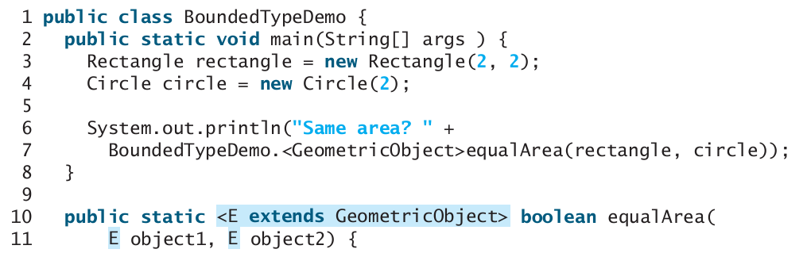

Bounded generic type

Slide 12
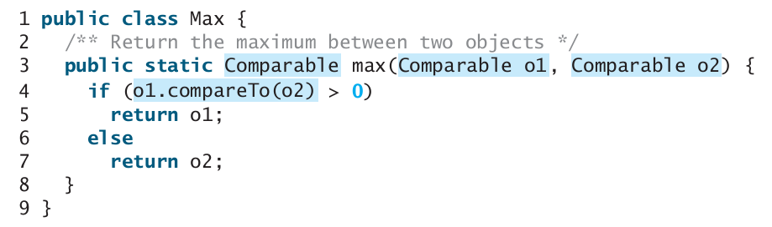
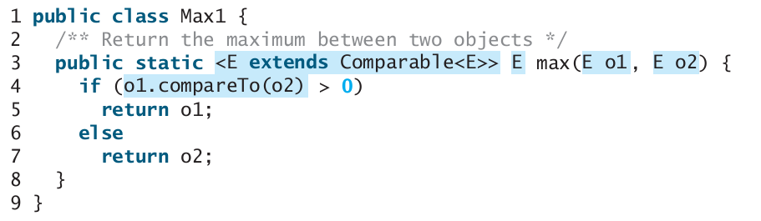
Bounded generic type

Slide 13
Bounded generic type
two arguments of the max method in Max1 must have the same type (e.g., two strings or two integer objects
The type E must be a subtype of Comparable<E>

Slide 14
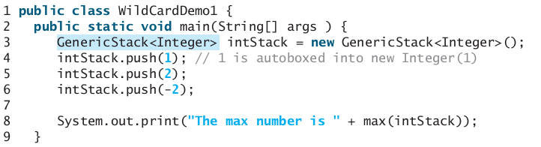
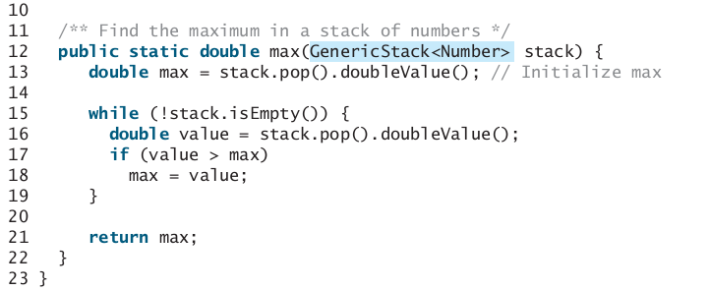
Wildcard Generic Types

Slide 15
Generics and Subtyping
Is the following code snippet legal?
List<String> ls = new ArrayList<String>()
List<Object> lo = ls;
If you believe it’s OK, take a look at the next few lines:
lo.add(new Object());
String s = ls.get(0);
➔Attempts to assign an object to a string

Slide 16
Wild Card with extends
The program has a compile error in line 8 because intStack is not an instance of GenericStack<Number>.
So you cannot invoke max(intStack) .
<? extends Number>is a wildcard type that represents Number or a subtype of Number .

Slide 17
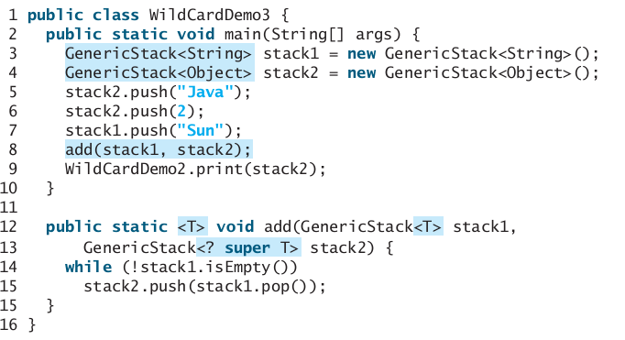
Wild cards with super

Slide 18
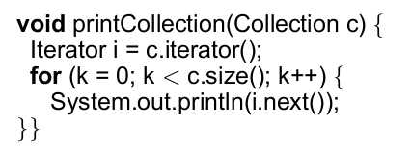
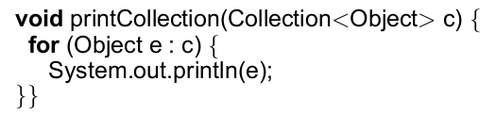
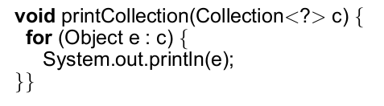
More about wildcards
Compare:
1
2
3

Slide 19
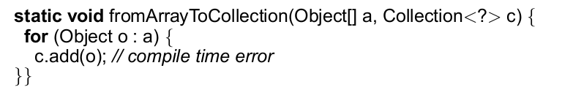
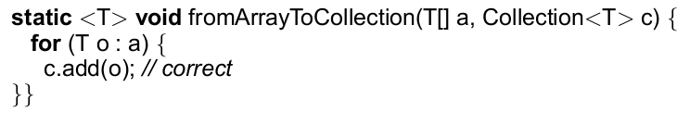
More about wildcards
Problems with Collection<?>

Slide 20
Type inference
Type inference is a Java compiler’s ability to look at each method invocation and corresponding declaration to determine the type argument that make the invocation applicable.
The inference algorithm tries to find the most specific type that works with all of the arguments.

Slide 21
Type inference
Example
static <T> T pick(T a1, T a2) {
return a2;
}
public static void main(String args[]) {
Serializable s = pick("d", new ArrayList<String>());
}

Slide 22
Erasure and Restrictions on Generics
Generics are implemented using an approach called type erasure. The compiler uses the generic type information to compile the code, but erases it afterward.
The generics are present at compile time. Once the compiler confirms that a generic type is used safely, it converts it to a raw type
So the generic information is not available at runtime.

Slide 23
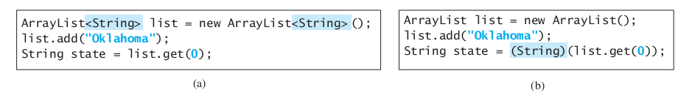
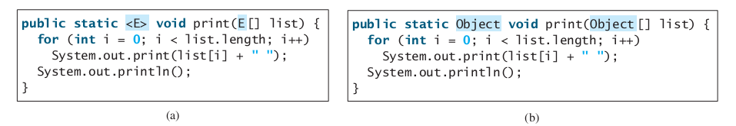
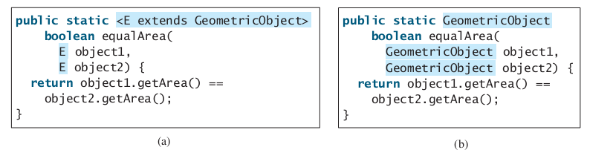
Erasure and Restrictions on Generics

Slide 24
Restrictions
Restriction 1: Cannot Use new E()
You cannot create an instance using a generic type parameter.
The reason is that new E() is executed at runtime, but the generic type E is not available at runtime.

Slide 25
Restrictions
Restriction 2: Cannot Use new E[]
Reason is same as new E()
You can circumvent this limitation by creating it to E[] , as follows:
E[] elements = (E[])new Object[capacity];

Slide 26
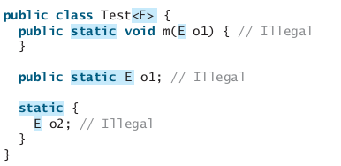
Restrictions
Restriction 3: A Generic Type Parameter of a Class Is Not Allowed in a Static Context
it is illegal to refer to a generic type parameter for a class in a static method, field, or initializer

Slide 27

Other Restrictions
Can not check type parameters at runtime

